Slide 1

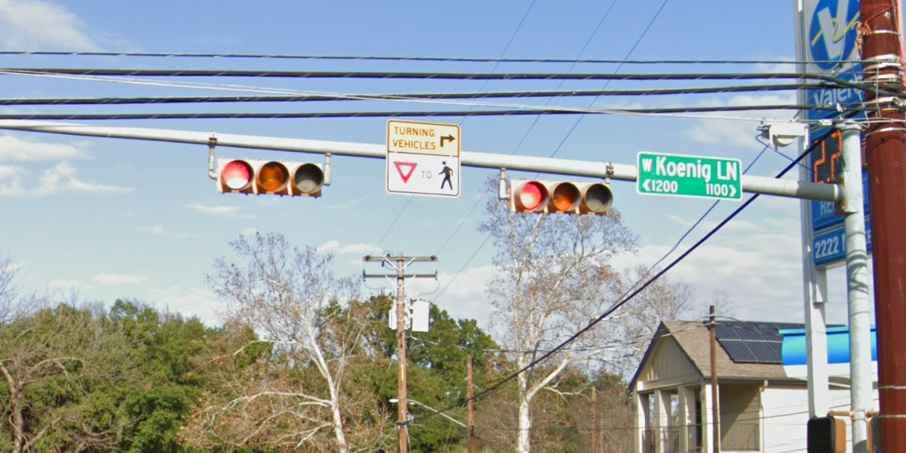
Austin Transportation Department Signs Work Orders
Created By: Susanne Gov Created Date: 2020-08-10 Location Name: KOENIG LN / GROVER AVE Intersection ID: 5158705 Cardinal Direction: N Work Order ID: SG-2012
Sign Type | Install/Remove
Street Name Sign | Install
Turning Vehicle Yield To Ped Symbol | Install

Slide 2
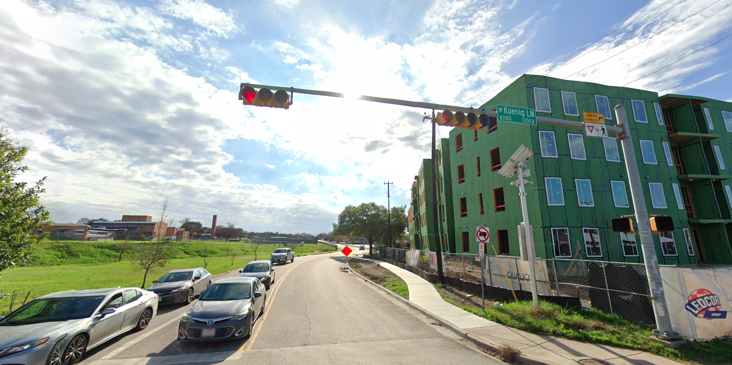
Austin Transportation Department Signs Work Orders
Created By: Susanne Gov Created Date: 2020-08-10 Location Name: KOENIG LN / GROVER AVE Intersection ID: 5158705 Cardinal Direction: S Work Order ID: SG-2012
Sign Type | Install/Remove
Street Name Sign | Install
Turning Vehicle Yield To Ped Symbol | Install

Slide 3
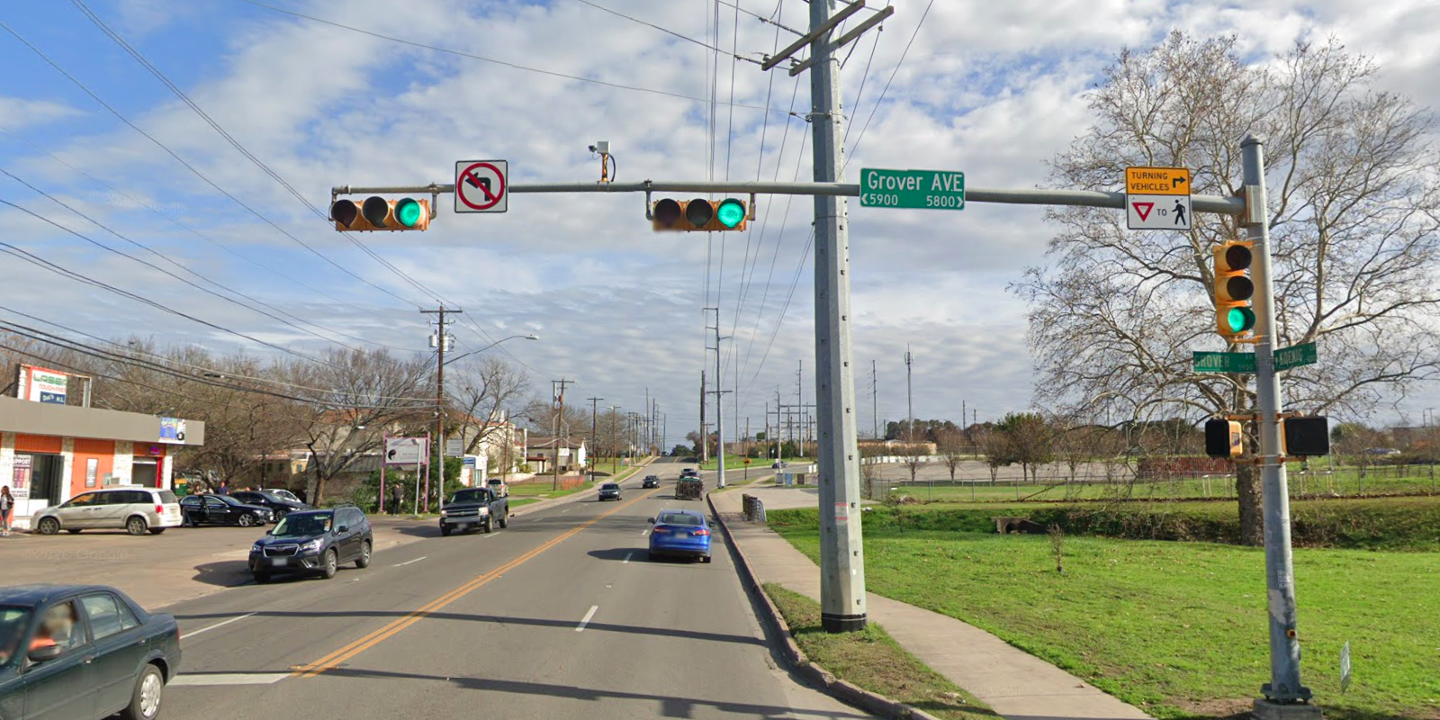
Austin Transportation Department Signs Work Orders
Created By: Susanne Gov Created Date: 2020-08-10 Location Name: KOENIG LN / GROVER AVE Intersection ID: 5158705 Cardinal Direction: E Work Order ID: SG-2012
Sign Type | Install/Remove
Street Name Sign | Install
No Left Turn Arrow | Install
Turning Vehicle Yield To Ped Symbol | Install

Slide 4
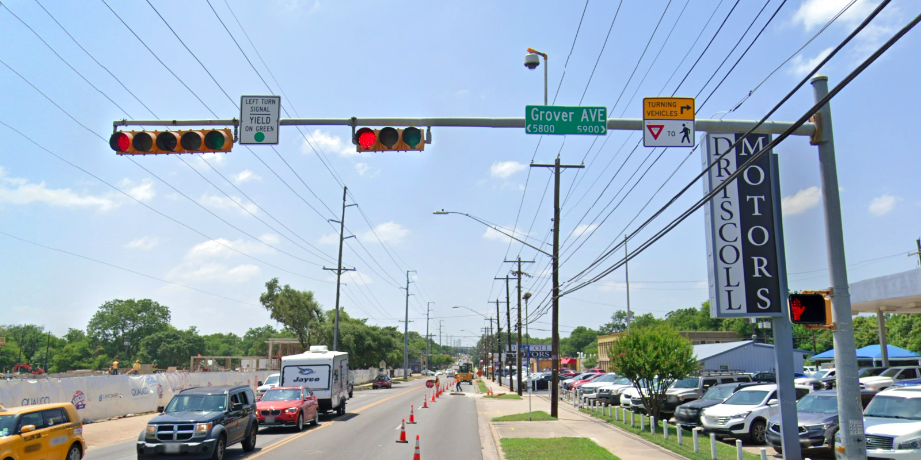
Austin Transportation Department Signs Work Orders
Created By: Susanne Gov Created Date: 2020-08-10 Location Name: KOENIG LN / GROVER AVE Intersection ID: 5158705 Cardinal Direction: W Work Order ID: SG-2012
Sign Type | Install/Remove
Left Turn Signal Yield On Green | Remove
Street Name Sign | Install
Turning Vehicle Yield To Ped Symbol | Install
Left Turn Yield On Green | Install

